Slide 1
Unidad 2:
Database Logical Design
Bases de Datos
1

Slide 2
UNIT 1 Database Logical Design
Data model
The representation of the problem: E/R diagrams
2.1 Entities
2.2 Attributes and types
2.3 Relationships
2.4 Cardinality
2.5 WeaknessThe expanded E/R model.
Construction of an E/R diagram
The relational model
Characteristics of a relationship.
Primary keys and foreign keys
Restrictions
Representation of the relational schema
Step from the E/R diagram to the relational model.
Standardization.
2

Slide 3
2.3 Relaciones
Relationship:It is an association between several entities through an action performable between those entities.
BUY (between CUSTOMER and PRODUCT)
COURSE (between STUDENT and MODULE)
BE_SON (between STUDENT and PARENT).
BE_BOSS (EMPLOYEE with self)
BUY (between the entities CUSTOMER, PRODUCT, SELLER)
3

Slide 4
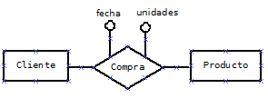
2.3 Relaciones
Binary Relationship or degree 2:
When it is given between 2 entities
Here we see that relationships may have attributes
4

Slide 5
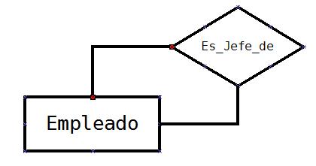
2.3 Relationships
Unary, reflexive or degree one relationship:When it occurs between elements of the same entity, that is, an element of an entity is related to one or more elements of the same entity
5

Slide 6
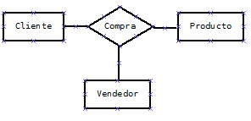
2.3 Relaciones
Ternary relationships or degree 3:
When it is given between 3 entities
6

Slide 7
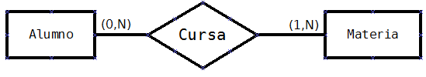
2.4 Cardinalidad
Occurrence: It is a unit of the set of elements that represents an entity. For the STUDENT entity, an occurrence of STUDENT is a specific student.
The cardinality of an entity A with respect to another B in a relationship indicates the minimum and maximum number of occurrences of entity A that can be related to an occurrence of entity B.
Cardinality is indicated by a pair of numbers enclosed in parentheses. The first number indicates the minimum number of related occurrences (it will always be a value of 0 or 1). The second number indicates the maximum number of related occurrences (it will always be a value of 1 or N for many).
7

Slide 8
2.4 Cardinalidad
Cardinalities that may happen in relationships are:
Cardinality | Meaning
(0,1) | Minimum zero, maximum one
(1,1) | Minimum one, maximum one
(0,N) | Minimum zero, maximum many
(1,N) | Minimum one, maximum many
8

Slide 9
2.5 Tipo de correspondencia
Type of correspondence or cardinality relationship: Expresses the maximum number of elements or occurrences that can be related between the entities of a relationship.
One to one (1:1): This would be the case of the MARRIED relationship between the PERSON and PERSON entities. A person may be married to another person but not to many. One to many (1:N): This would be the case of the BELONGS relationship between the MUNICIPALITY and PROVINCE entities. A municipality can only belong to one province, while many municipalities belong to a province.
Many to many (N:M): This would be the case of the PURCHASE relationship between the entities PRODUCTS and CUSTOMERS. A customer can buy several products and the same type of product will be purchased by several customers.
9

Slide 10
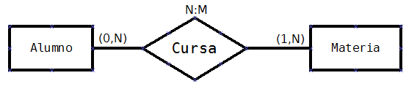
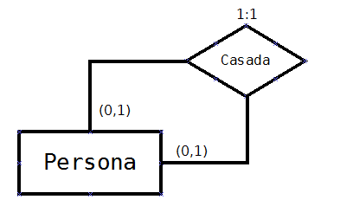
2.5 Tipo de correspondencia
Cardinality representation and correspondence
10

Slide 11
2.5 Tipo de correspondencia
Ejercicio 1:
Learning activity 1
In a supermarket there are products organized into categories. Each product belongs to a single category. Categories are planned that may not yet have products. Calculate the cardinalities of each entity and the type of correspondence and represent them in the E/R schema.
11

Slide 12
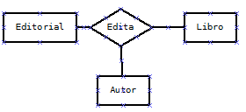
2.5 Tipo de correspondencia
Exercise 2:
Find out the cardinality of each entity in the following relationships
12

Slide 13
2.5 Tipo de correspondencia
Ejercicio 2: Solución.
To establish the cardinality of a ternary relationship we must ask ourselves the following questions:
Publisher Cardinality: Given a book-author pair, what is the minimum number of publishers we will have? And the maximum? Publisher(1,1))
Book Cardinality: Given a publisher-author pair, what is the minimum number of books we will have? And the maximum? Book (0,N)
Author Cardinality: Given a book-publisher pair, what is the minimum number of authors we will have? And the maximum? Author(1,N).
The cardinaliy of the relationship will be 1:N:N
13

Slide 14
2.5 Tipo de correspondencia
Learning activity 3:
Calculate the correspondence types of the following relations:
Person married to person (in Spain)
Person married to person (in Saudi Arabia)
Player plays as a team
Product contains piece
14

Slide 15
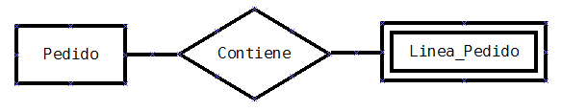
2.6 Debilidad
An entity is weak compared to another that is strong when for an element of the weak to exist it is necessary for an element of the strong to exist.
For example, in the order and sales management of a business, an order consists of several order lines (one for each product). If ORDER is an entity and ORDER_LINE is another entity, ORDER would be a strong entity and ORDER_LINE a weak entity with respect to the previous one.
Weak entities are represented on E/R diagrams surrounded by a double line:
15

Slide 16
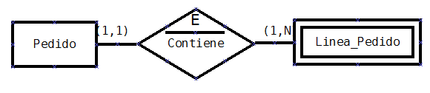
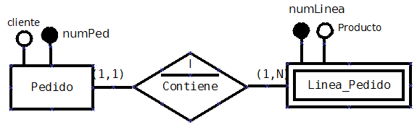
Dependencies in relationships of weakness:
Dependency on existence: Occurrences of a weak entity are meaningless in the database without an occurrence of the strong entity to which they are related.
Dependency in identification: In addition to the dependency in existence, the weak entity needs the strong entity to be able to create a key from the key that the strong entity has. That is, in the example, each order line would be identified with numPed and numLinea.
2.6 Debilidad
16

Slide 17
3.- El modelo E/R ampliado
Extended E/R model: Collects all the concepts and specifications of the E/R model and adds others to improve the design of the databases.
Superclass: It is a generic entity from which other entities are derived. The superclass has attributes that the entities that derive from them will also have.
Subclass: It is an entity that derives from a generic entity or superclass. The subclass will have the attributes of the superclass plus some specific attributes. The elements that are in the subclass will also be in the superclass, although the superclass will normally contain many more elements.
For example, EMPLOYEE would be a superclass and OPERATOR and MANAGER would be subclasses of it. In a study center PERSON could be a superclass while STUDENT and TEACHER would be subclasses.
17

Slide 18
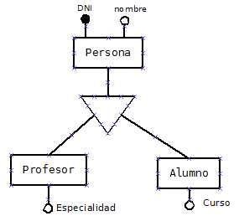
3.- El modelo E/R ampliado
Generalization is the process of constructing a superclass from the common or shared characteristics of several subclasses of the information system.
A generalization is represented
through an inverted triangle
that unites the superclass and the
subclasses.
18

Slide 19
3.- El modelo E/R ampliado
Specialization is the reverse process of generalization. In specialization it is about looking for:
The specific attributes of the subclasses.
The existence restrictions of elements of the entities.
According to the restrictions on the existence of elements of the entities, we can find the following types of specialization or generalization:
Total exclusive specialization or generalization
Specialization or partial exclusive generalization
Total overlapping specialization or generalization
Partial overlapping specialization or generalization
19

Slide 20
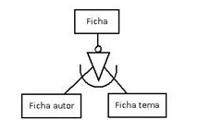
3.- El modelo E/R ampliado
Total exclusive specialization: Because it is exclusive, an element of the superclass can only be in a subclass. Because it is total, all the elements of the superclass are in one of the subclasses.
20

Slide 21
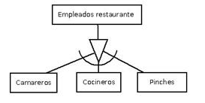
3.- El modelo E/R ampliado
Partial exclusive specialization: Because it is exclusive, an element of the superclass can only be in a subclass. Because it is partial, not all the elements of the superclass have to be in any of the subclasses.
21

Slide 22
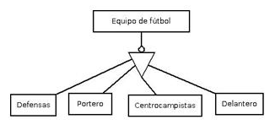
3.- El modelo E/R ampliado
Total overlapping specialization: Because it is overlapping, an element of the superclass could belong to several subclasses. Because it is total, all the elements of the superclass are in one of the subclasses.
22

Slide 23
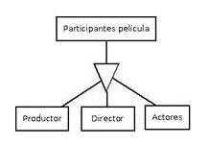
3.- El modelo E/R ampliado
Partial overlapping specialization: Because it is overlapping, an element of the superclass could belong to several subclasses. Because it is partial, not all the elements of the superclass have to be in any of the subclasses.
23

Slide 24
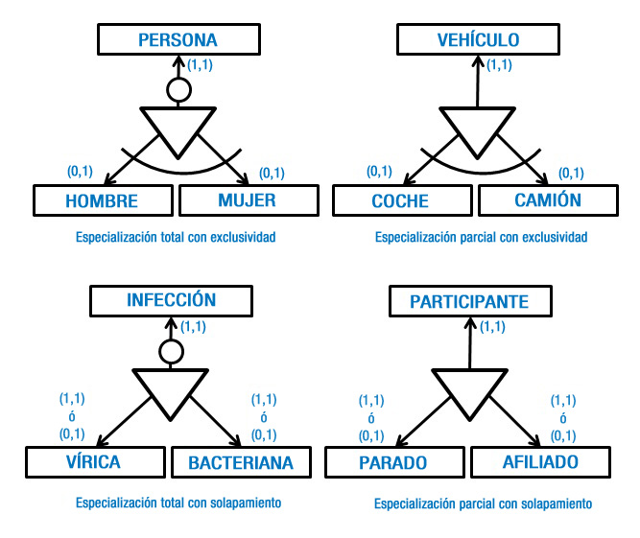
3.- El modelo E/R ampliado
Specialization cardinalities:
24

Slide 25
It is a methodological process, that is, we will follow a method to reach the result. The steps to follow will be:
Read the document several times until you understand the problem well and are clear about all the information we have.
Get a list of candidate entities, relationships, and attributes:
Identify the entities. The basic subjects in the system.
Find the attributes of each entity. Propose the primary key for each one. Establish attribute types (composite, multivalued, optional, derived). Establish your domains (Date, real number with two decimal places, character string of length 9, V/F…)
Identify generalizations and specializations (types of specializations total exclusive, partial overlapping...)
Identify relationships of weakness, strong and weak entities. Existence or identification dependencies.
4.- Construcción de un diagrama E/R
25

Slide 26
Find out the cardinalities and types of correspondence in each relationship.
Review what was obtained to:
Delete derived entities.
See if it is necessary to add entities to any relationship.
See if some attributes of an entity should be grouped as attributes of a new entity.
Make a distribution of the entities and represent their relationships in the diagram as well as the attributes.
Reread the problem to see if we have left something out. Review that all the information is represented in the diagram and refine it if necessary.
4.- Construcción de un diagrama E/R
26

